Slide 1
Processing Big Data with Hive

Slide 2
What is Hive?

Slide 3
SELECT…
A metadata service that projects tabular schemas over folders
Enables the contents of folders to be queried as tables, using SQL-like query semantics
Queries are translated into jobs
Execution engine can be Tez or MapReduce

Slide 4
set hive.execution.engine=mr;
SELECT…
set hive.execution.engine=tez;
SELECT…
Map
Map
Map
Map
Reduce
Reduce
Map
Map
Reduce
Reduce
Map
Map
Map
Map
Reduce
Reduce
Reduce
Reduce
Map
Map
Reduce
Reduce
Notes:
Tez = DAG (directed acyclic graph)
The key point is that there are less Map operations, so less I/O overhead.

Slide 5

Hive client tools include…
Hive Shell
Visual Studio
Any ODBC Client
SELECT…
SELECT…
Query Console (Hue)
PowerShell
SELECT…

Slide 6
How do I create and load Hive tables?

Slide 7
Use the CREATE TABLE HiveQL statement
Defines schema metadata to be projected onto data in a folder when the table is queried (not when it is created)
Specify file format and file location
Defaults to textfile format in the <database>/<table_name> folder
Default database is in /hive/warehouse
Create additional databases using CREATE DATABASE
Create internal or external tables
Internal tables manage the lifetime of the underlying folders
External tables are managed independently from folders

Slide 8
Internal table (folders deleted when table is dropped)
CREATE TABLE table1
(col1 STRING,
col2 INT)
ROW FORMAT DELIMITED FIELDS TERMINATED BY ' ';
Default location (/hive/warehouse/table1)
CREATE TABLE table2
(col1 STRING,
col2 INT)
ROW FORMAT DELIMITED FIELDS TERMINATED BY ' '
STORED AS TEXTFILE LOCATION '/data/table2';
Stored in a custom folder (but still internal, so the folder is deleted when table is dropped)
CREATE EXTERNAL TABLE table3
(col1 STRING,
col2 INT)
ROW FORMAT DELIMITED FIELDS TERMINATED BY ' '
STORED AS TEXTFILE LOCATION '/data/table3';
External table (folders and files are left intact in Azure Blob Store when the table is dropped)

Slide 9
Hive data types :
Numeric
Integers: TINYINT, SMALLINT, INT, BIGINT
Fractional: FLOAT, DOUBLE, DECIMAL
Character
STRING, VARCHAR, CHAR
Date/Time
TIMESTAMP
DATE
Special
BOOLEAN, BINARY, ARRAY, MAP, STRUCT, UNIONTYPE
abc
1011001
123
1-Jan-16

Slide 10
Save data files in table folders (or create table on existing files!)
Use the LOAD statement
Use the INSERT statement
Use a CREATE TABLE AS SELECT (CTAS) statement
PUT myfile.txt /data/table1
LOAD DATA [LOCAL] INPATH '/data/source' INTO TABLE MyTable;
INSERT INTO TABLE Table2
SELECT Col1, UPPER(Col2),
FROM Table1;
CREATE TABLE Table3
ROW FORMAT DELIMITED FIELDS TERMINATED BY '\t'
STORED AS TEXTFILE LOCATION '/data/summarytable'
AS
SELECT Col1, SUM(Col2) As Total
FROM Table1
GROUP BY Col1;

Slide 11
How do I query Hive tables?

Slide 12
Query data using the SELECT HiveQL statement
Hive translates the query into jobs and applies the table schema to the underlying data files
SELECT Col1, SUM(Col2) AS TotalCol2
FROM MyTable
WHERE Col3 = 'ABC' AND Col4 < 10
GROUP BY Col1
ORDER BY Col4;

Slide 13
Views are named queries that abstract underlying tables
CREATE VIEW v_SummarizedData
AS
SELECT col1, SUM(col2) AS TotalCol2
FROM mytable
GROUP BY col1;
SELECT col1, TotalCol2
FROM v_SummarizedData;

Slide 14
Partitioning, Skewing, and Clustering Tables

Slide 15
CREATE TABLE part_table
(col1 INT,
col2 STRING)
PARTITIONED BY (col3 STRING);
part_table
INSERT INTO TABLE part_table PARTITION(col3='A')
SELECT col1, col2
FROM stg_table
WHERE col3 = 'A';
col3='A'
SET hive.exec.dynamic.partition = true;
SET hive.exec.dynamic.partition.mode=nonstrict;
INSERT INTO TABLE part_table PARTITION(col3)
SELECT col1, col2, col3
FROM stg_table;
col3='B'
col3='C'

Slide 16
CREATE TABLE skewed_table
(col1 INT,
col2 STRING,
col3 STRING)
SKEWED BY (col3) ON ('A') [STORED AS DIRECTORIES];
skewed_table
col3='A'
INSERT INTO TABLE skewed_table
SELECT col1, col2, col3
FROM stg_table;
Others

Slide 17
CREATE TABLE clust_table
(col1 INT,
col2 STRING,
col3 STRING)
CLUSTERED BY (col3) INTO 3 BUCKETS;
clust_table
INSERT INTO TABLE clust_table
SELECT col1, col2, col3
FROM stg_table;

Slide 18
How do I use Hive in Visual Studio?

Slide 19
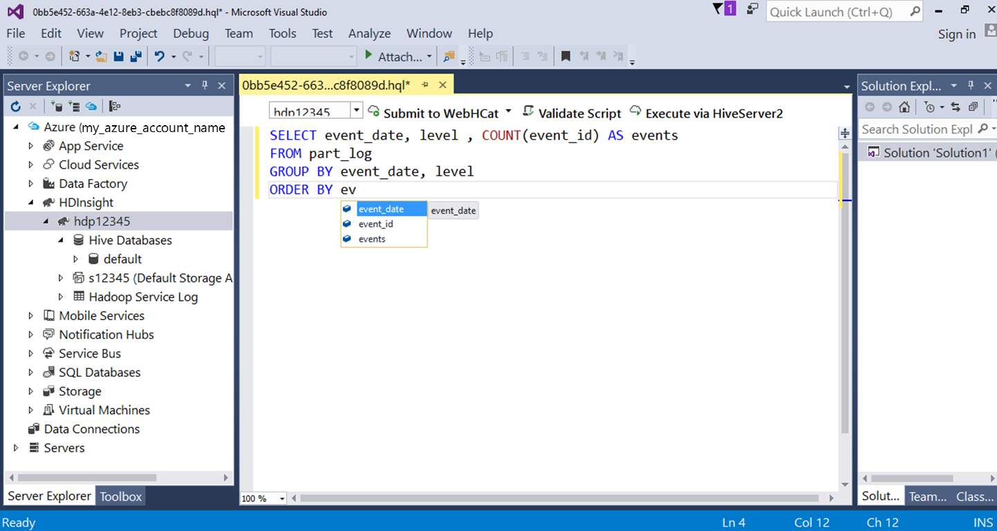
Azure SDK for .NET includes HDInsight tools for Visual Studio
Visual Hive table designer
Hive query editor

Slide 20
How do I access Hive via ODBC?

Slide 21
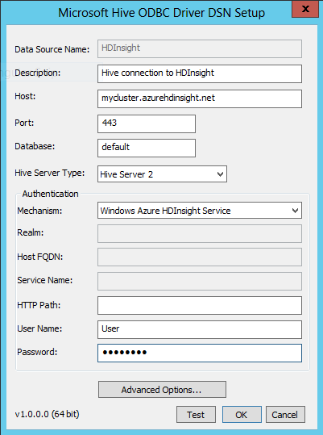
Download and install the Hive ODBC Driver for HDInsight
32-bit and 64-bit versions
Optionally, create a data source name (DSN) for your HDInsight cluster
Use an ODBC connection to query Hive tables

